Slide 1

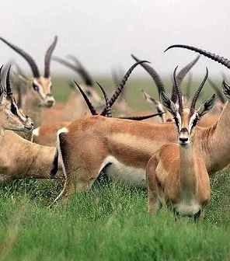
The Tibetan antelope.
Author: Chris Young

Slide 2
Table of contents
Description
Physical Properties
Habitat of Tibetan antelope
Diet of Tibetan antelope
How do we protect them

Slide 3
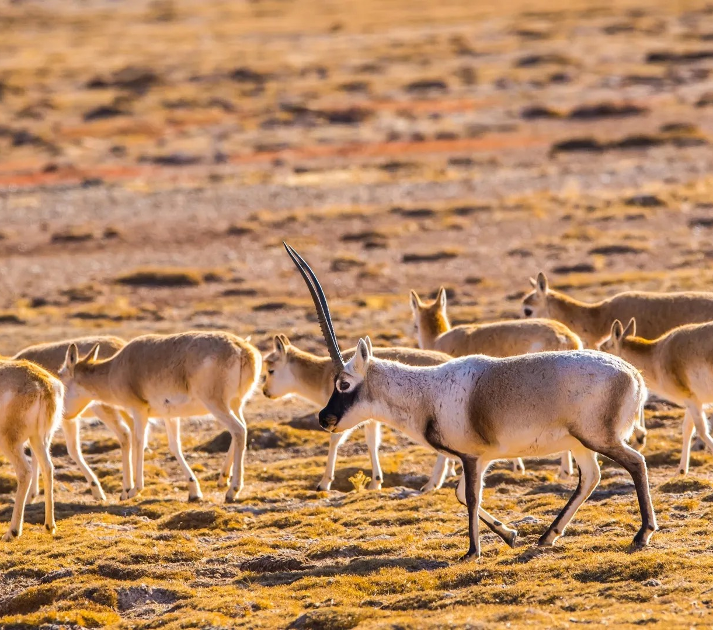
Description
The limbs are well-proportioned and strong. Caudal short, apex pointed. The whole body is thick and fluffy, straight hair shape.
Notes:
Let me introduce some appearance of Tibetan antelope to you.

Slide 4
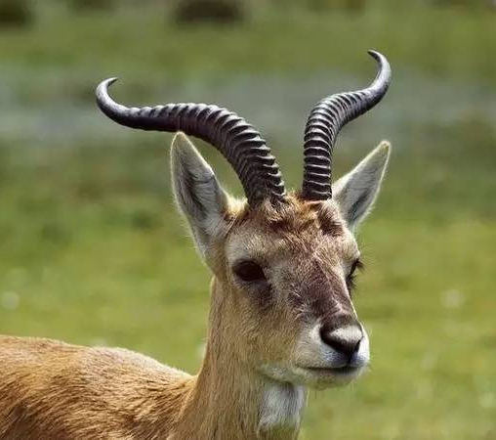
Tibetan antelope.
Physical Properties
The general color is brown, some face black
Length：80-85cm (male)70-75cm (female)
Weight：35-40kg (male) 24-28kg (female)
Lifespan：Usually no more than 8 years old
Notes:
I would like to introduce the characteristics of this animal

Slide 5
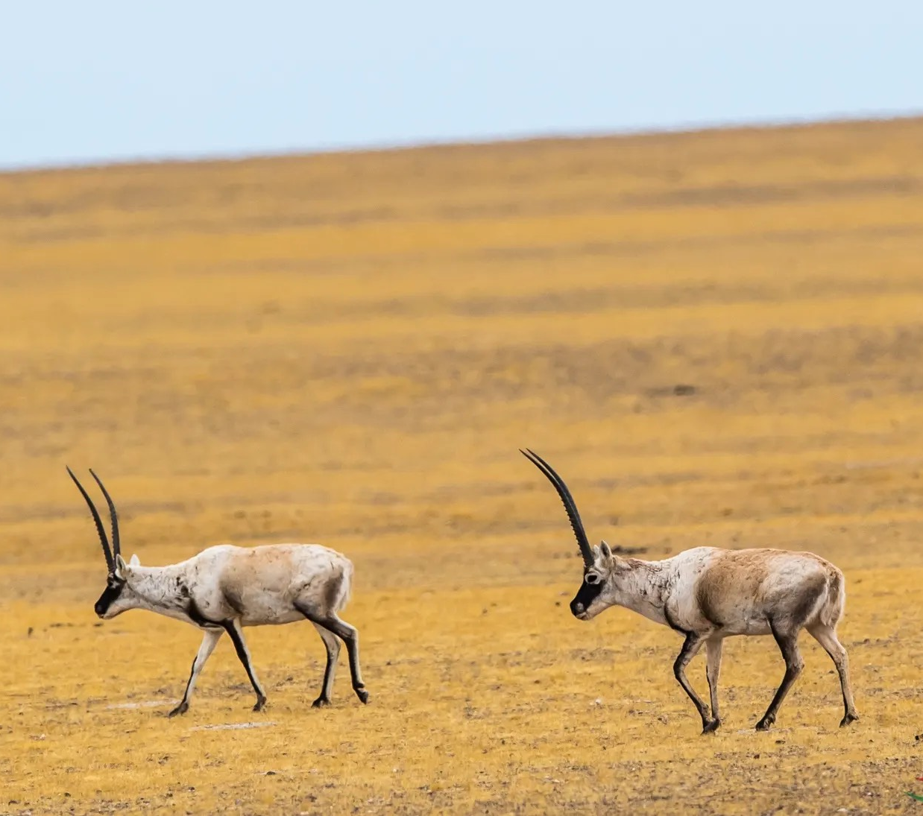
Habitat of Tibetan antelope
The Tibetan antelope lives on the Tibetan Plateau And there are a few in Africa
Notes:
I'm going to tell you about the habitat of this animal。

Slide 6
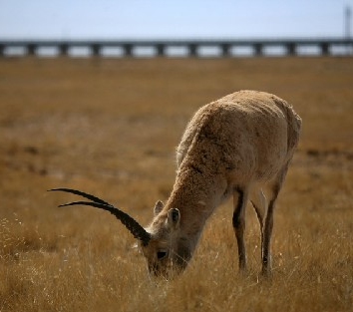
Diet of Tibetan antelope
The food of Tibetan antelopes mainly includes gramineae food, legumes food
Notes:
Finally, I would like to introduce its diet

Slide 7
How do we protect them
Don't interfere with their lives
Don't buy products made from them
We could volunteer to join a conservation group,
Notes:
We can protect them through these methods, although we can not establish protection areas like the government, but we can use our own way to let more people know about them, to protect them together

Slide 8
Reference
https://baike.baidu.com/item/藏羚羊的介绍/14741310?fr= Author：Baidu encyclopedia
Photos https://www.birdnet.cn/forum.php?mod=viewthread&tid=4299881
https://www.sohu.com/a/132375917_696845
https://new.qq.com/rain/a/20210924a06ey300
20210924a06ey300

Slide 9
Thank you for listening😄

